Slide 1
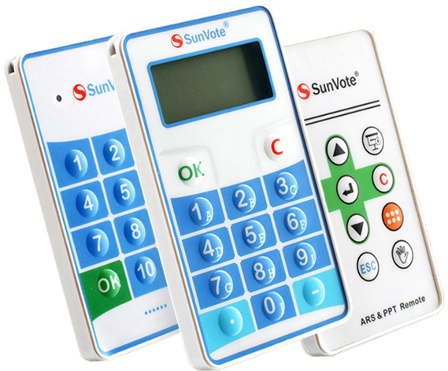
An introduction to your SunVote-system

Slide 2
Contents
Install the software
Connect the base unit
Create keypad questions
Test your system
Connect to a web channel (optional)

Slide 3
Install the software
Web based-installation (recommended)
  Install the Mentometer Plug-in for PowerPoint® using the link:
  http://www.mentometer.nu/webinstall.html
  If you have PowerPoint® 2010-2013 (64-bit version) you also need to install:
  http://www.mentometer.nu/software/Setup64.exe
  Launch PowerPoint® and go to the Mentometer-tab and select 'About Mentometer'. Click on 'Enter registration code'.
  Copy and paste the registration code you received when purchasing the software, excluding the asterisk signs (*). It must be an EXACT copy.
  Close and re-start PowerPoint®. You should now find your username when you go to 'About Mentometer'.
Off-line installation/network installation
  Download the installation-CD from http://www.mentometer.nu and copy “Setup.msi” from the Software-folder. Create a text file ”license.txt” containing the license key.
  Install the software silently with the command:
  ”msiexec /qn /i Setup.msi / log install.log”
  Copy the ”license.txt” file to the program files directory
  (Default: “C:\Program Files\Johansson Consulting\Mentometer Plug-in for PowerPoint®”)

Slide 4
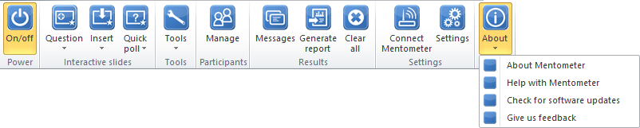
Maintain the software…
Use the ’Check for software updates’ feature to keep your software up-to-date. ’Check for software updates’ is only available for web-based installations and requires administrator's rights.

Slide 5

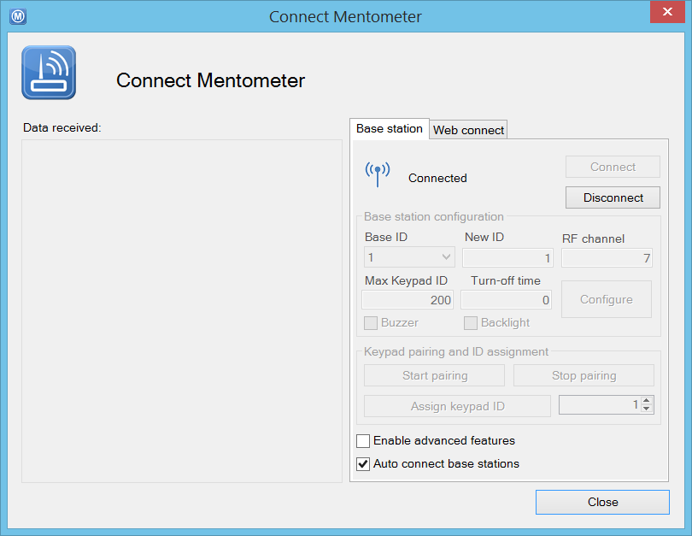
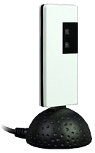
Connect your base unit to the computer
Connect the base unit to an available USB-port. Launch PowerPoint®. Go to the Mentometer-tab, click ’Power On/off’ and select ’Connect Mentometer’
Connect the base station to a USB-port
Verify that the base station’s status is ”Connected”

Slide 6
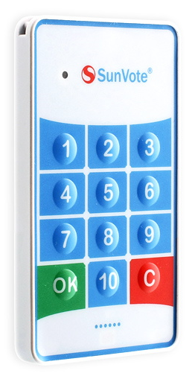
About your M50 response keypad
Press any key to turn the keypad on
Respond to the interactive questions by pressing the appropriate answer key
(key 1-10). Confirm by pressing OK*.
The indicator LED will turn steady green when the base unit has received your choice.
Turn the keypad off by pressing and holding C for 3 seconds. The keypad will turn itself off after 10 minutes of inactivity
The keypad is powered by two CR2032-batteries with an expected lifetime of 1 year.
*It is not necessary to confirm the choice with OK for single-choice questions.

Slide 7
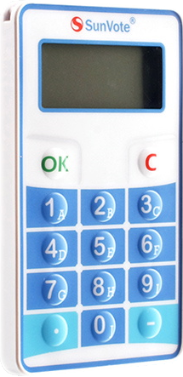
About your M52 response keypad
Press any key to turn the keypad on
Respond to the interactive questions by pressing the appropriate answer key (key 1-10). Confirm your choice by pressing OK*.
Turn the keypad off by pressing and holding C for 3 seconds. The keypad will turn itself off after 10 minutes of inactivity
The keypad is powered by two CR2032-batteries with an expected lifetime of 1 year.
*It is not necessary to confirm the choice with OK for single-choice questions.
Low-battery warning
The OK-sign will be shown when the base unit has received your choice.
Signal strength

Slide 8
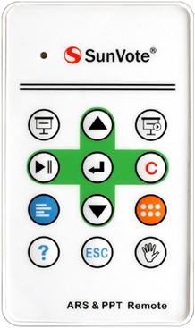
About your M50R remote control
Start slide show from current slide
Start slide show from first slide
Start/pause voting
Clear voting results
Simulate voting data
Reveal correct answer (if it is hidden)
Start quick poll

Slide 9
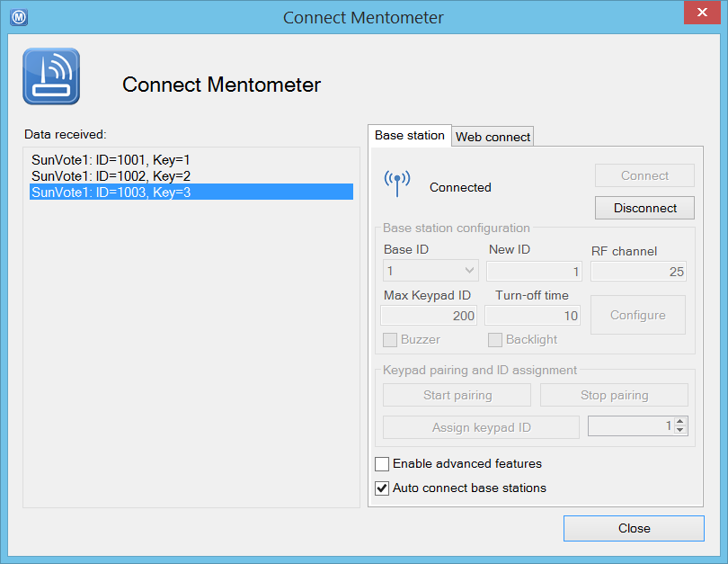
Test the base unit connection…
Vote with a couple of keypads and verify that the votes are received
Try voting with a couple of keypads to verify the connection. If you are in a large auditorium, test voting from the back row to verify the range.

Slide 10
Create your first interactive question!

Slide 11
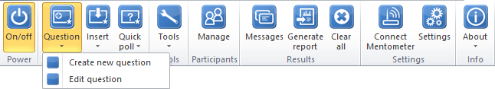
Select ’Create new question’

Slide 12
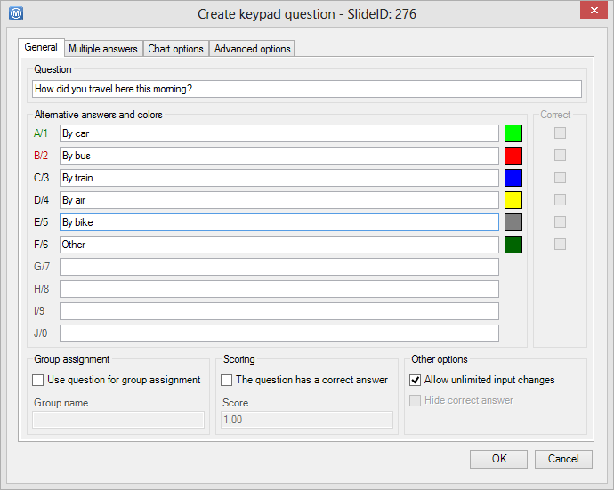
Enter your question and answers…
Enter your question and the different alternative answers.
Change the answer’s color by clicking on the color field to the right of each answer.

Slide 13
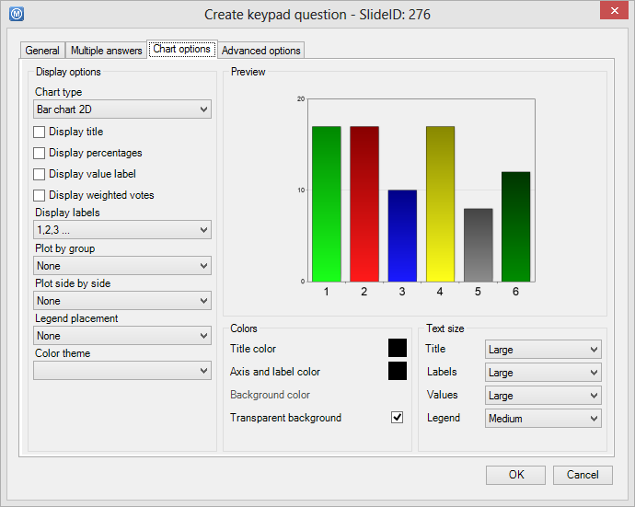
Enter your question and answers…
Click on the ’Chart option’ tab and select how you want to present the result. Click ’OK’ when you are done.

Slide 14
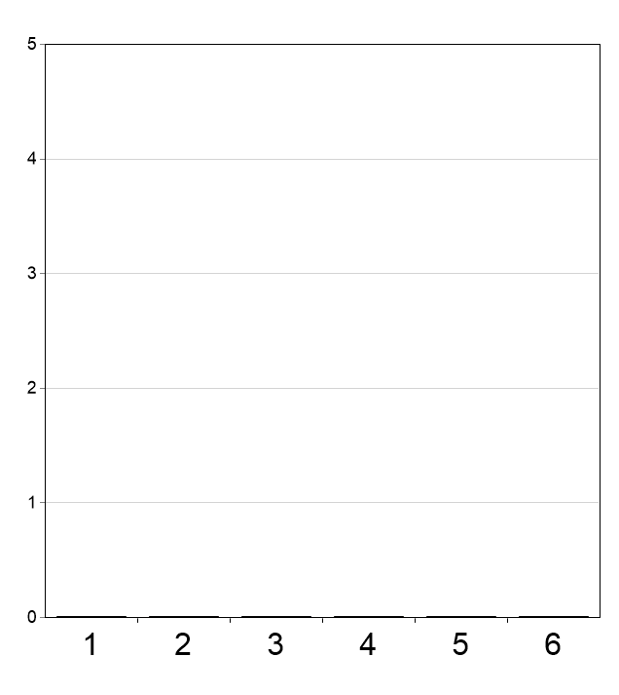

How did you travel here this morning?
By car
By bus
By train
By air
By bike
Other
Now, your interactive question has been created! The presentation must be in SlideShow-mode and powered on to accept incoming votes.

Slide 15

Test your mentometer…
Run the following slides in slideshow mode and use your keypads to vote…
Remember to power on the system before starting…

Slide 16
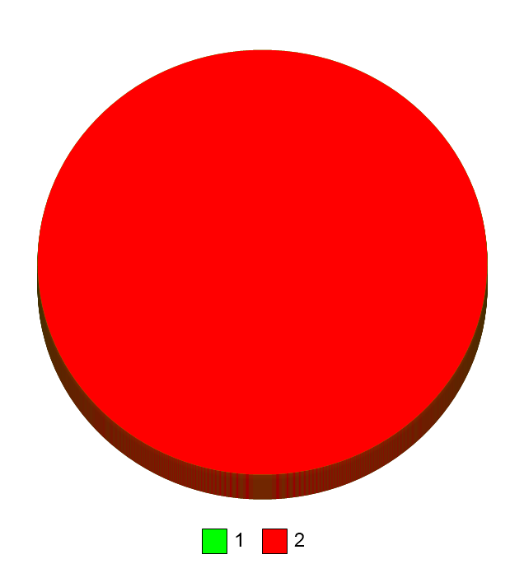
Is it the first time you test a mentometer system?
Yes
No
Tips! You can simulate 50 random keypad clicks by pressing <Ctrl>-<Alt>-V

Slide 17

Please state your age
< 25 years
25-35 years
35-45 years
45-55 years
55-65 years
> 65 years
Tips! This question is used to divide the participants into different categories base on age. Select Question > Edit question to see how group assignments are done

Slide 18
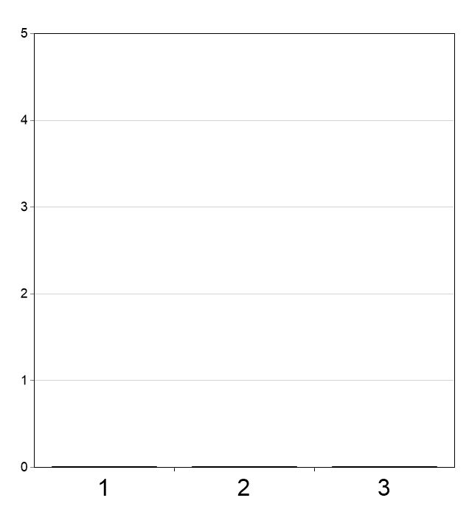
Does the system seem easy to operate?
Yes
No
Do not know
Tips! Right-click and select ”Plot by > Age” to see how different age groups have answered.

Slide 19



Which brand do you prefer?
1
2
A bit more advanced… you can present the results in any way you like using tilde-codes …
0%
0%

Slide 20


What was Abraham Lincoln's profession before he became the US President?
Lawyer
Soldier
Professor
Doctor
Tips! ”Unhide correct answer” eller tryck <Ctrl>-<Alt>-U för att avslöja svaret

Slide 21
Top ten-list
Keypad ID | Name | Score | Total time
- | - | 0 | 0
- | - | 0 | 0
- | - | 0 | 0
- | - | 0 | 0
- | - | 0 | 0
- | - | 0 | 0
- | - | 0 | 0
- | - | 0 | 0
- | - | 0 | 0
- | - | 0 | 0
Create the leaderboard by using
Insert > Participants leaderboard…

Slide 22
How would you rate the probability of occurrence?
Very low
Low
Medium
High
Very high

Slide 23
How would you rate the impact?
Very low
Low
Medium
High
Very high

Slide 24

Probability vs. impact
Create more advanced plots using Insert > Graph.

Slide 25
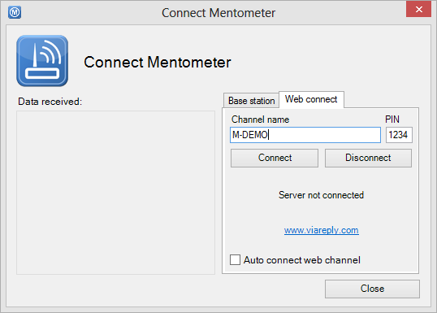
Connect to a web-channel
Connect to internet to allow the participants to vote with any web-enabled device, e.g. smartphones, ipads, laptops etc.
Check ”Auto connect web channel” for automatic login every time you power on the Mentometer plug-in.
Connect the computer to
the internet
Enter channel
name and PIN
Click Connect

Slide 26
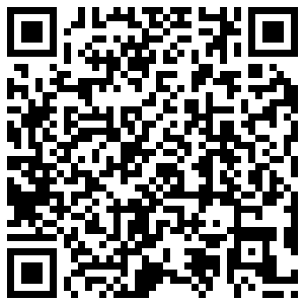
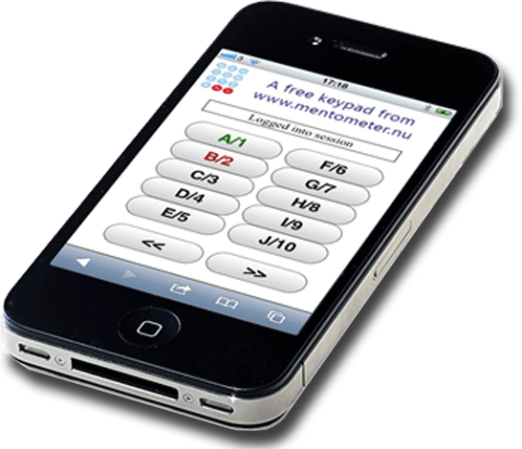
Connect web-keypads…
Surf to www.viareply.com
Enter channel name=M-DEMO
Enter PIN=1234
Click Login
Or, scan the QR-code
Or, send a direct link to the participants:
http://www.viareply.com/keypad.aspx?SessionID=M-DEMO&PIN=1234
Replace ’M-DEMO’ and ’1234’ with your channel name and PIN. Tips! There are many free tools for generating QR-codes on the internet, e.g. http://qrcode.kaywa.com or http://www.qrstuff.com

Slide 27
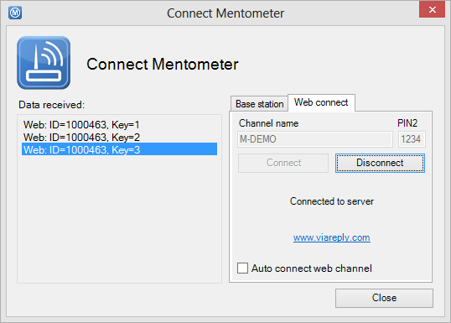
Test the web-connection…
Vote and verify that the votes are received
Vote with a web-keypad to verify the connection

Slide 28

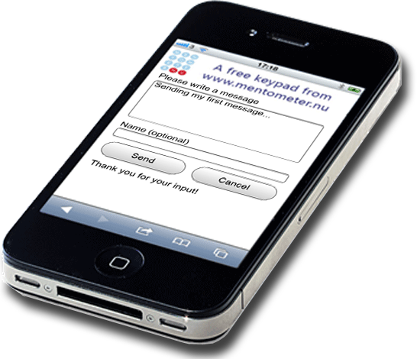
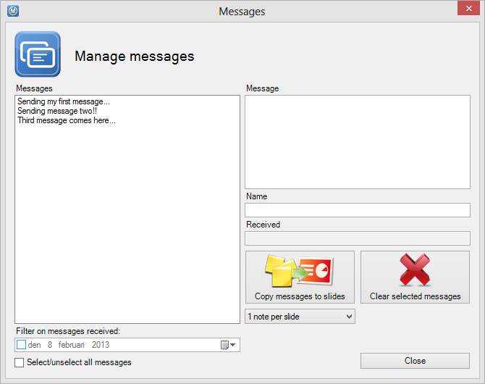
Test the web-connection…
Verify that the text messages are received
Click on ’Messages’ in PowerPoint® and ’Send message…’ on the web-keypad. Send some text messages.

Slide 29
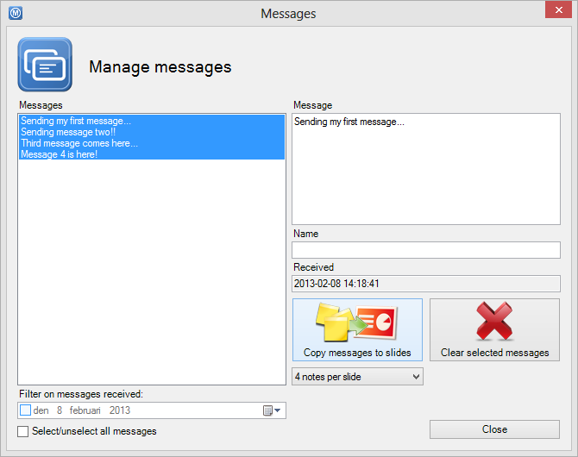
Sending my first message...
Sending message two!!
Select the messages and click on ’Copy messages to slides’
Third message comes here...
Message 4 is here!

